Slide 1
Health and Safety in the Workplace
Information
Emergencies and conduct
Milan, November 2015

Slide 2
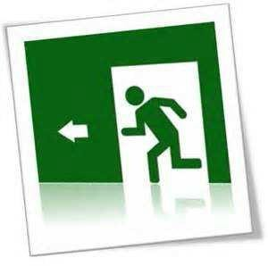
EMERGENCIES Emergency management - Introduction
This document has the aim of informing faculty, staff and students at Università Commerciale “Luigi Bocconi” on the internal procedures for handling emergencies and the correct conduct to engage in.
In particular, the following is described:
The reasons for writing an emergency plan;
The kinds of emergency;
Procedures provided for in the emergency plan;
Tasks of representatives involved in handling emergencies;
Proper conduct;
The location of various meeting points for University buildings.

Slide 3
EMERGENCIES Emergency management – Organizational actions
Bocconi University has executed the following organizational actions:
• Implementation of detection, alarm and fire warning systems;
• Placement of equipment for the prevention of and protection against fires;
• Maintenance of alarm and security systems, and equipment for the prevention of and protection against fires;
• Implementation of signage;
• Preparation of Emergency Plans, emergency response teams, coordination and connection with external intervention methods (e.g. fire department, 118, law enforcement);
• Training of emergency teams;
• Informing, educating and training workers;
• Creating and maintaining the efficiency of escape routes and exits, emergency doors and stairs;
• Organizing meetings for training emergency representatives;
• Performing evacuation drills at least once per year.

Slide 4

EMERGENCIES Emergency management – Definition of emergency and types
Any deviation from normal operational conditions, which could result in situations that are dangerous to people, the environment and things is defined at “emergency”.
Some examples of emergencies:
Injury
Accident
Fire
Explosion
Trespassing
Theft
Earthquake collapse of facilities or equipment
Flooding due to atmospheric precipitation or water leaks

Slide 5
EMERGENCIES Emergency management – Actors in emergencies
Bocconi University, with the prevention and protection service, has drafted the Internal Emergency Plan.
The main procedures for handling emergencies and the names and tasks of actors in handling emergencies are included.
ACTORS IN EMERGENCIES
COORDINATOR OF THE EMERGENCY
or substitute
EMERGENCY RESPONSE TEAM
(Team within Bocconi University)
FIRE EMERGENCY REPS
FIRST AID REPS EVACUATION REPS
First aid representatives are in each University building
Evacuation representatives are in each University building
Fire emergency representatives are in each University building

Slide 6

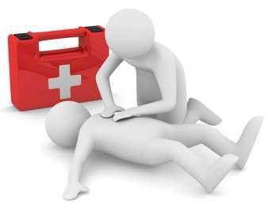
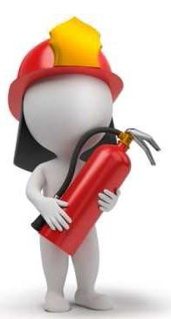
EMERGENCIES Emergency management – Actors in emergencies
The actors in emergencies are appointed by the Employer and have received adequate training on the risk of the activity.
Coordinator of emergency team
Has the task of: coordinating emergency representatives, verifying the correct application of procedures of the Internal Emergency Plan, intervening to resolve and contain the emergency, guiding people toward the closest security exits, verifying that areas have effectively been evacuated, intervening to help people in difficulty. Is the person in charge of communicating with external aid organizations (Police, 118, Fire Department, etc.).
Emergency Response Team Rep
Representatives appointed to intervening immediately to verify the type and level of emergency. Trained as fire representatives and first aid representatives
Fire Rep
Representatives appointed to carrying out measures for fire prevention, fighting fires and handling emergencies.
First Aid Rep
Representatives appointed to carrying out measures for internal first response and to activate first aid intervention.
Tasks
During the emergency, have the task of: following the Coordinator’s directions, intervening to resolve and contain the emergency, guiding people toward the closest security exits, verifying that areas have effectively been evacuated, intervening to help people in difficulty, communicating any critical situations to the Coordinator.
Evacuation Rep
Has the task of: following the indications of the Coordinator, guiding people toward the closest security exits, verifying that areas have effectively been evacuated, intervening to help people in difficulty, communicating any critical situations to the Coordinator.

Slide 7
EMERGENCIES Emergency management – Reporting and communicating emergencies
Anyone who observes a dangerous situation or an emergency must communicate it immediately to the internal emergency number.
REPORTING EMERGENCIES TO THE BOCCONI UNIVERSITY PHONE EXTENSION
21. 21
OR
02. 58362121
Indications should be as complete as possible to allow the emergency team to reach the place of intervention.
Any anomalies observed, material placed/abandoned along exit paths, suspicious people, suspicious packages/materials should also be reported to the emergency number.

Slide 8
EMERGENCIES Emergency management – Reporting and communicating emergencies
Example of communicating an emergency to the phone extension 21.21 or 02.58362121:
“Pronto, chiamo dall’edificio di via ……………..;
vorrei segnalare un’emergenza, descrivere la tipologia di
emergenza, presso la stanza n°/zona al piano …….
Il mio nominativo è ……………………………………………………”
“ Ripeto, chiamo dall’edificio di via ……………..;
vorrei segnalare un’emergenza, descrivere la tipologia di
emergenza, presso la stanza n°/zona al piano …….
Il mio nominativo è ……………………………………………………”
“Hello, I’m calling from the building at via ……………..;
and I would like to report an emergency, describe the type of
emergency, in room no./area on floor …….
My name is ……………………………………………………”
“To repeat, I’m calling from the building at via ……………..;
and I would like to report an emergency, describe the type of
emergency, in room no./area on floor …….
My name is ……………………………………………………”

Slide 9
EMERGENCIES Emergency management – Stages of an emergency
EMERGENCY
Report to number 21.21
The Coordinator of the emergency, with the support of several representatives of the emergency team, goes to the place to assess the seriousness of the situation and to intervene as much as possible
The Coordinator of the emergency assesses the seriousness of the situation and if it is necessary to evacuate the area and intervenes, where possible and based on previous training, with the help of the Representatives of the internal emergency team, with the means available (extinguishers and hydrants)
Has the situation been resolved
NO
END OF EMERGENCY
YES
GENERAL EVACUATION OF THE ENTIRE BUILDING

Slide 10
EMERGENCIES Emergency management – Stages of an emergency
GENERAL EVACUATION OF THE ENTIRE BUILDING
The Coordinator of the emergency activates the procedure to alert all Fire and Evacuation Representatives; personnel in charge of deactivating machinery will be alerted (electricity, gas, heating/cooling) and at the same time external aid organizations are alerted (Fire Department, 118, Police).
The Fire Reps and Evacuation Reps receive the call and go to their posts as quickly as possible.
The Fire Reps and Evacuation Reps guide people towards the closest safety exits; after checking that all areas have been evacuated, they abandon their posts and go to the:
MEETING POINT
10/23

Slide 11

EMERGENCIES Emergency management – What to do during an evacuation
General rules for orderly evacuation:
If you discover an emergency, call the internal extension (21.21 or
02.58362121);
wherever you are, always identify the exit closest to you;
if you hear the alarm, leave the building quietly, using the nearest exit;
do not tarry to retrieve personal belongings;
follow the instructions of the emergency team;
do not run along the escape routes and along the stairs;
do not use the elevators;
do not stand in the immediate vicinity of the exit, so as not to hinder rescue personnel;
the call to external relief agencies (fire brigade, 118, Law Enforcement) will be made by the Coordinator in charge of emergency management;
once out of the building quickly head over to the meeting point;
do not enter the building; wait for the signal or the coordinator of emergency workers.

Slide 12



EMERGENCIES Emergency management – What to do in case of fire
What to do in case of fire:
report the blackout to the internal emergency number (21:21 or 02.58362121);
• move away from the fire;
• non do not attempt put out the fire if you are not trained in the use of the firefighting equipment;
• remain calm and follow the instructions of the emergency team personnel or firefighters;
• if possible close the windows and doors of your office before leaving;
• but do not waste time gathering personal belongings;
• do not occupy the telephone lines;
• do not use elevators
If there is smoke, walk crouched low where the air is better
• if you can, protect your lungs by breathing through a wet handkerchief ;
• the use of firefighting equipment is permitted only for emergency team personnel and firemen;
• proceed to the outdoor meeting point for your building.

Slide 13
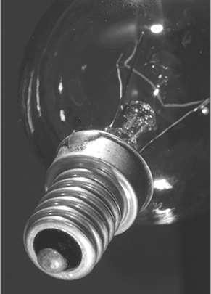


EMERGENCIES Emergency management – What to do in case of an emergency
What to do in case of a blackout:
report the blackout to the internal emergency number (21:21 or 02.58362121);
remain calm and follow the instructions of the emergency team personnel;
do not occupy the telephone lines;
do not use elevators.
What to do in case of a flood:
report the flooding to the internal emergency number (21:21 or 02.58362121);
remain calm and follow the instructions of the emergency team personnel;
do not occupy the telephone lines;
do not use elevators.
What to do in case of a bomb scare:
stay away from the suspicious object; do not attempt to identify it or remove it;
report the suspicious object or threatening call to the internal emergency number (21:21 or 02.58362121);
remain calm and follow the instructions of the emergency team personnel;
do not occupy the telephone lines

Slide 14
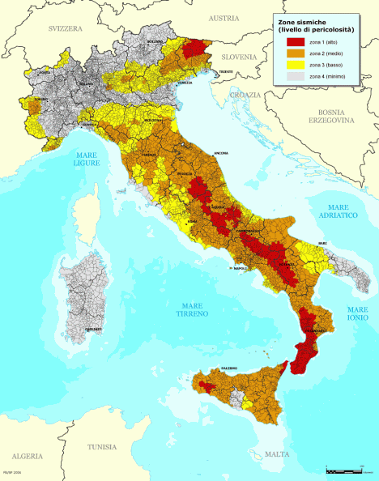
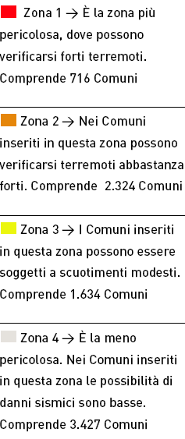
EMERGENCIES Emergency management – What to do in case of an earthquake
What to do in case of an earthquake :
If you are outdoors
The main danger comes from what may collapse and you should be careful not to stand or pass under parts of buildings (balconies, eaves, gutters etc.) that might fall; good shelter can be found in the frame of a doorway.
A car is a good shelter and therefore stay there in, unless it breaks down or is blocked under bridges, billboards and pylons, etc.
In a city on the sea it may happen that an earthquake will produce waves of considerable height that move very quickly; such waves are a real danger for those who are close to the coast, so it is advisable to stay away from the beaches for several hours.
If you are inside a building
The main risk is the collapse of the structure and, at the same time, the falling over of furniture and shelves; it is therefore essential to identify what might be the "strong points" of the structure (usually the supporting parts, lintels, doorways and corners in general) and go to one of them.
At the same time try to get away from furniture that could fall on you; It can be appropriate to try to find shelter under the table or the bed; in the office you can hide under desks or stand against a bearing wall, at a point away from windows that could shatter and cause injury.
t r o v o ?
m i
z o n a
c h e
I n

Slide 15
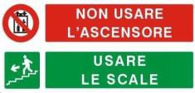



EMERGENCIES Emergency management – What to do in case of an earthquake
What to do in case of an earthquake :
Once the earthquake has ended, you must:
• exit calmly; use the stairs, following the escape routes marked, not the elevator, which might stop suddenly or even fall;
• smell the air, absolutely do not light any open flames; if you smell a leak of gas, open doors and windows and, if possible, report it;
• Do not use the land line phone or your car: the phone lines and roads must be free for first responders (Fire Brigade -Red Cross etc.);
• move to the meeting point, or at least in open areas where relief can easily reach you (sports grounds, public gardens, wide squares) and do not stand near waterways. Do not return to the office unless authorized by the emergency coordinator;
• pay close attention to hygienic conditions (breakage of pipes or sewers may result in pollution of drinking water);
If you are in a house, go out quietly after closing water, electricity and gas.

Slide 16
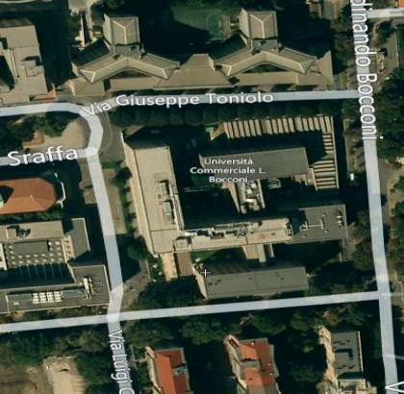
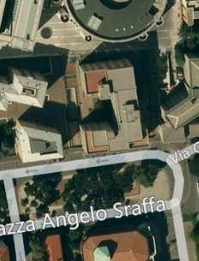
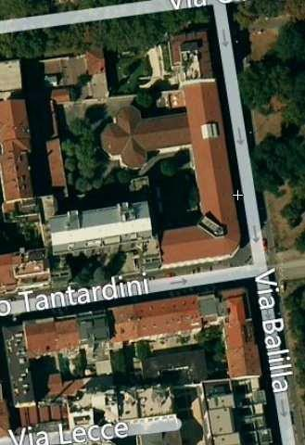
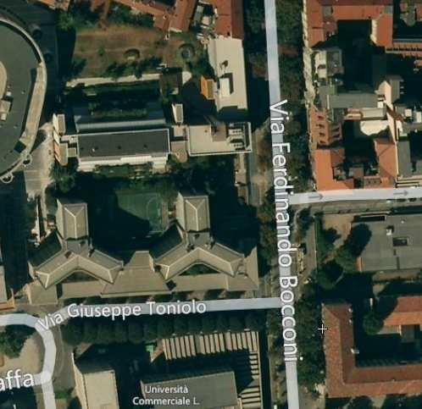
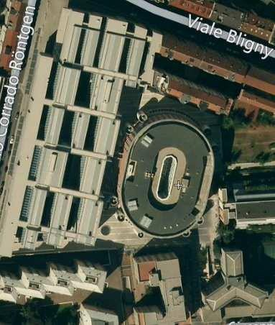
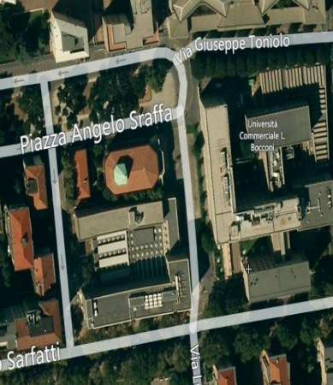
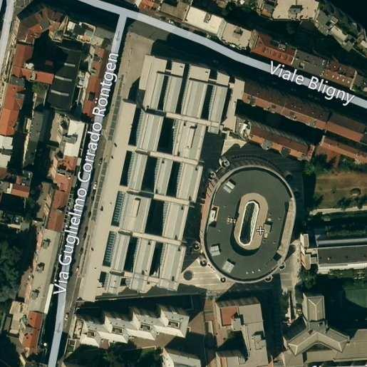
EMERGENCIES Emergency management – What to do in case of emergency
Each building of Bocconi University has a meeting point, a secure outdoor area to gather at and report any problems occurring during evacuation.
In the following pages the meeting points for all University buildings are specified .

Slide 17
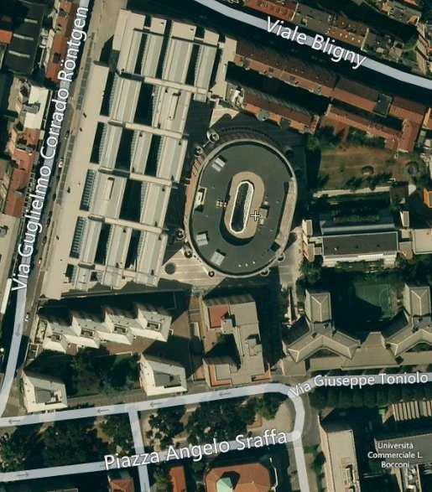
EMERGENCIES Emergency management– Meeting points
Meeting Point for
P.zza Sraffa 13 building Velodromo
Piazza Sraffa

Slide 18
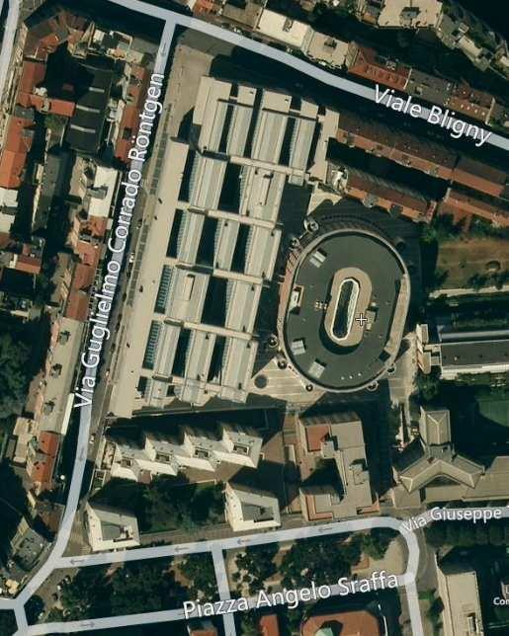
EMERGENCIES Emergency management– Meeting points
Meeting Point for
Via Röntgen 1 building
Point A - Viale Bligny
Point B – Between
Via Röntgen and Velodromo

Slide 19
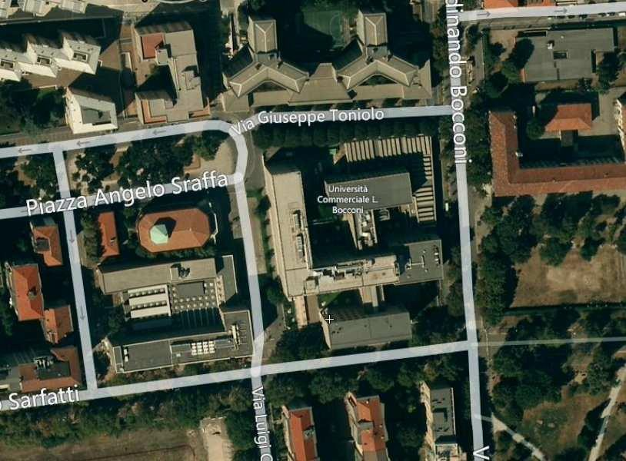

EMERGENCIES Emergency management– Meeting points
Meeting Point for
Via Sarfatti 25 building
Point A – Piazza Sraffa
Point B – Via Bach (Parco Ravizza)

Slide 20
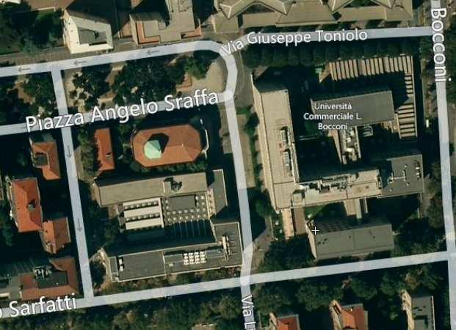

EMERGENCIES Emergency management– Meeting points
Meeting Point for
Via Ulisse Gobbi 5 - Library
Meeting Point for
Via Ulisse Gobbi 1 – Study Area
Piazza Sraffa
20/23

Slide 21
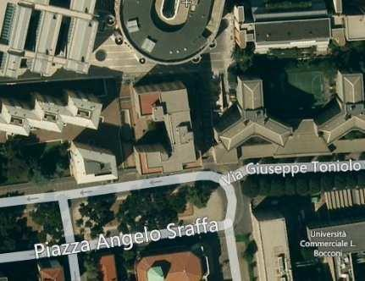
EMERGENCIES Emergency management– Meeting points
Meeting Point for
Piazza Sraffa 11 building
Meeting Point for Offices in
Piazza Sraffa 15 building
Piazza Sraffa

Slide 22
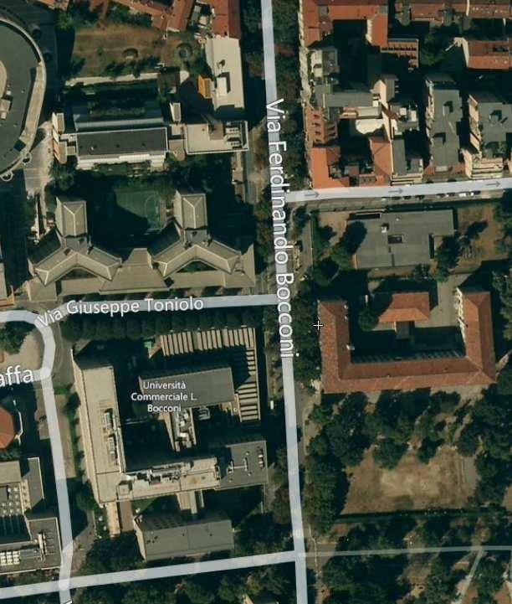
EMERGENCIES Emergency management– Meeting points
Meeting Point for
Via Bocconi 8 building
Via Bach (Parco Ravizza)

Slide 23
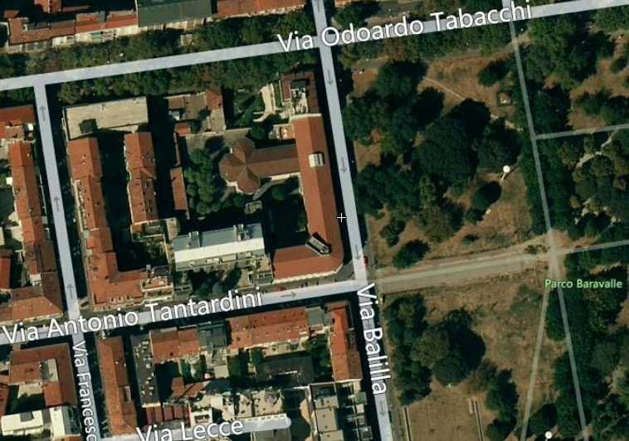
EMERGENCIES Emergency management– Meeting points
Meeting Point for
Via Balilla 18 Building
Park Baravalle

